Slide 1

USED TO

Slide 2
USED TO
Vazba, kterou používáme, když chceme říci, že něco nějak bývalo. Teď je to však jinak. Často pokud porovnáváme minulost se současností.
Např.
I used to have long hair. But now I have got short hair.
I didn´t use to like mushrooms, but now I like them.
Did you use to travel a lot when you were a child?
Yes, I did. No, I didn´t.

Slide 3
Kladné věty:
When I was a teenager I used to smoke.
But I don´t smoke at all now.
In the past people used to walk everywhere but now we travel by cars, trains, underground or planes.
We used to go skiing every year but nowdays we are too busy for that.
I used to play tennis a lot. These days I play golf.

Slide 4

Pokuste se utvořit podobné věty:
Past Present
I/be a shop assistant I/ be a manager
I/share a flat with my sister I/live alone
We/get up at 8 o´clock We/get up earlier
The house/be damaged It/be repaired
Grandad/have curly hair He/be bold

Slide 5
Klíč:
I used to be a shop assistant but now I am a manager!
I used to share a flat with my sister but now I live alone.
We used to get up at 8 o´clock but now we get up earlier.
The house used to be damaged but now it is repaired.
Grandad used to have curly hair
but now he is bold.

Slide 6

Záporné věty
I didn´t use to wear glasses but now I have to.
People didn´t use to phone in the past. Now we can´t imagine our life without a phone.
People didn´t use to go to the cinema 200 years ago. Nowdays it´s a common way of entertainment.
He didn´t use to read when he was a boy but now he reads a lot.
              It used to be our house. Now we live in a flat.

Slide 7
Zkus přeložit věty:
Lidé v minulosti neposílali e-maily, ale psali dopisy.
Nenosila jsem sukně, teď je nosím každý den.
Petr nedělal žádný sport, teď hraje florbal.
Lidé nekupovali ovoce a zeleninu v supermarketu, vše pěstovali na zahradě.
Děti dříve nehráli hry na počítači, teď
tráví u počítače mnoho času.

Slide 8
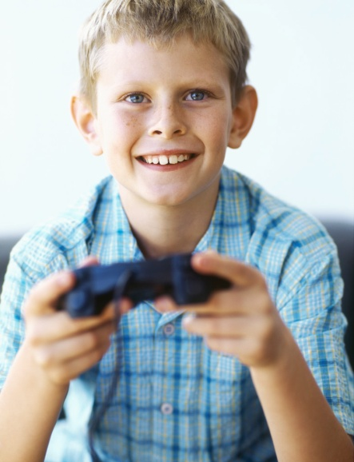
Klíč:
People didn´t use to sed emails in the past but they wrote letters.
I didn´t use to wear skirts but I wear a skirt every day.
Petere didn´t use to do any sport but now he plays florball.
People didn´t use to buy fruit and vegetable in a supermarket but they grew everything in the garden.
Children didn´t use to play pc games in the past but now they spend too much time at their pc.

Slide 9

Otázky:
What books did you use to read when you were younger?
Did you use to do any sport when you were a boy?
How did people use to spend their free time?
Did you use to eat vegetable when you were a child?
What school did you use to go to?
What musical instrument did you use to play?

Slide 10
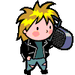
Procvičte si otázky:
Jedl jsi zeleninu, když jsi byl dítě?
Jakou profesi dělal tvůj dědeček?
Kde bydleli lidé v době kamenné?
Jakou hudbu jsi poslouchal když jsi byl teenager?
Kde jste bydlívali?

Slide 11
Klíč:
Did you use to eat vegetable when you were a child?
What profession did your grandad use to do?
Where did people use to live at the stone age?
What music did you use to listen to when you were a teenager?
Where did you use to live?

Slide 12
Good job!

Slide 13
Použití učebního materiálu:
Tento materiál je určen pro žáky 8. tříd k procvičení
vazby used to. Při této prezentaci žáci tvoří kladné,
záporné i tázací věty.
Použité zdroje: klipart Microsoft PowerPoint
HUTCHINSON, Tom a Lynda EDWARDS. 3. vyd.
Oxford: Oxford University Press, c2009, 79 s. ISBN 978-019-4763-615

